Slide 1

Green Pace
Security Policy Presentation
Developer: Scotty Intondi
CS 405
Professor Dr.Toni Farley
Southern New Hampshire University 8/15/2024

Slide 2

OVERVIEW: DEFENSE IN DEPTH
The purpose of this security policy is to set a standard for best practices in securing applications. Defense in Depth’s strategy is to add layers of security measures to mitigate security breaches.

Slide 3
THREATS MATRIX
Priority: Most likely to happen with high severity
Likely: likely to happen with low severity
Low Priority: Unlikely to happen with low severity
Unlikely: Unlikely to happen but with a high severity
Likely STD-003-CPP STD-007-CPP | Priority STD-004-CPP STD-005-CPP
Low priority STD-001-CPP STD-002-CPP STD-006-CPP | Unlikely STD-008-CPP STD-009-CPP STD-010-CPP

Slide 4
10 PRINCIPLES
Validate Input Data
STD-001-CPP, STD-003-CPP,STD-004-CPP,STD-006-CPP
Heed Compiler Warnings
STD-001-CPP, STD-002-CPP, STD-003-CPP,STD-007-CPP
Architect and Design for Security Polices
STD-001-CPP, STD-002-CPP,STD-005-CPP,STD-006-CPP, STD-007-CPP,STD-008-CPP,STD-010-CPP
Keep It Simple
STD-002-CPP, STD-004-CPP, STD-008-CPP,STD-009-CPP, STD-010-CPP
Default Deny
STD-009-CPP
Adhere to the Principle of Least Privilege
STD-009-CPP,STD-004-CPP
Sanitize Data Sent to Other Systems
Practice Dense in Depth
STD-005-CPP
Use Effective Quality Assurance Techniques
STD-003-CPP, STD-005-CPP,STD-006-CPP, STD-007-CPP,STD-008-CPP,STD-010-CPP
Adopt a Secure Coding Standard
STD-001-CPP, STD-002-CPP, STD-003-CPP,STD-004-CPP,
STD-005-CPP,STD-006-CPP,STD-007-CPP,STD-008-CPP,STD-009-CPP,STD-010-CPP

Slide 5
CODING STANDARDS
STD-004-CPP – Sanitize data passed to complex subsystems
STD-005-CPP – Do not access freed memory
STD-009-CPP – Obey the one-definition rule
STD-003-CPP - Do not attempt to modify string literals
STD-008-CPP – Do not use std::rand() for generating pseudorandom numbers
STD-007-CPP – Handle all exceptions
STD-010-CPP – Close files when they are no longer needed
STD-001-CPP – Do not write syntactically ambiguous declarations
STD-002-CPP – Do not delete an array through a pointer of the incorrect type
STD-006-CPP – Use a static assertion to test the value of a constant expression

Slide 6
ENCRYPTION POLICIES
Encryption | Explain what it is and how and why the policy applies.
Encryption at rest | Encryption at rest secures stored data by encrypting it when not in use. This protects data from unauthorized access, ensures compliance with regulations, and helps manage risk by keeping sensitive information confidential.
Encryption in flight | Encryption in flight protects data while it is being transmitted over a network by using secure protocols and encryption algorithms. This prevents unauthorized access and tampering, and is essential for compliance and maintaining trust.
Encryption in use | Encryption in use protects data while it is actively being accessed or processed. Techniques like data masking, homomorphic encryption, and secure enclaves ensure data remains secure and private during use. This policy is important for protecting sensitive information, meeting compliance requirements, and mitigating insider threats.

Slide 7
TRIPLE-A POLICIES
Triple-A Framework* | Explain what it is and how and why the policy applies.
Authentication | Authentication verifies the identity of users or systems before granting access, using methods like passwords or biometric data. It is crucial for controlling access, enhancing security, and meeting regulatory requirements.
Authorization | Authorization determines what authenticated users or systems are allowed to do by defining access rights and permissions. It ensures proper access management, enhances security, and supports compliance with access control policies.
Accounting | Accounting involves tracking and recording user activities and system events through logs. It ensures accountability, enhances security by detecting anomalies, and supports compliance with regulations.

Slide 8
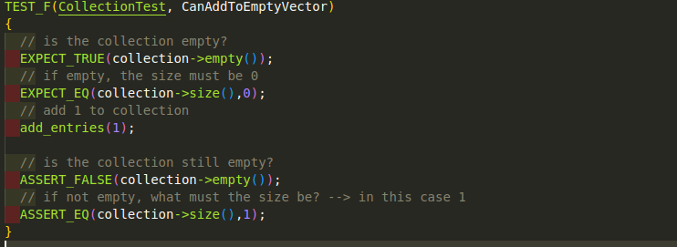
Unit Testing(+)
Can Add To Empty Vector?

Slide 9
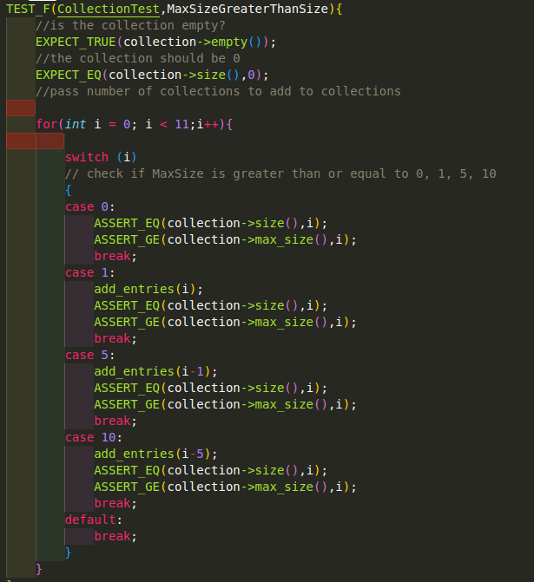
Unit Testing(+)
Max Size Greater Than Size?

Slide 10
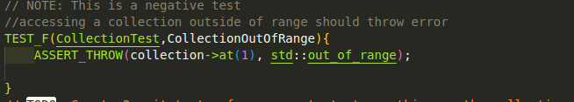
Unit Testing(-)
Collection Out of Range?

Slide 11
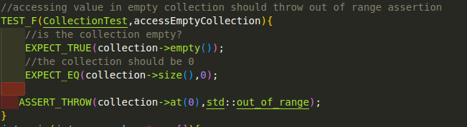
Unit Testing(-)
Access Empty Collection?

Slide 12

AUTOMATION SUMMARY

Slide 13
TOOLS
Pre-Production:
Planning: Assess threats and plan responses.
Designing: Implement security-first practices with automated unit testing and dependency checks (e.g., OWASP).
Building: Use trusted open-source repositories and automate security checks.
Testing: Utilize Static Analysis tools to automatically detect vulnerabilities.
Production:
Penetration Testing: Perform automated security tests and vulnerability assessments.
Logging and Revision Control: Automate logging and track changes to identify issues.
Incident Response: Ensure automatic shutdown of affected services and system rollback if an attack occurs.

Slide 14
RISKS AND BENEFITS
Pre-Production Phase:
Problems: Manual security checks can lead to vulnerabilities and inefficiencies.
Solutions: Automate unit testing and dependency checks, and use trusted sources for open-source components.
Immediate Action: Benefits include improved security and efficiency, while risks involve initial costs and integration challenges. Waiting could increase vulnerability exposure and inefficiencies.
Production Phase:
Problems: Slow response to attacks and inadequate logging.
Solutions: Automate penetration testing, enhance logging, and implement automated incident response.
Immediate Action: Benefits include faster detection and response, while risks involve high initial costs and potential integration issues. Waiting might delay improvements and increase breach risks.

Slide 15
RECOMMENDATIONS
Assess and Integrate:
Review Current Tools: Evaluate existing DevOps tools and identify where automation can improve efficiency and security.
Automate Testing: Implement automated tools for unit testing, static analysis, and checking open-source components.
Enhance Production Security:
Automate Penetration Testing: Regularly use automated tools to identify vulnerabilities.
Improve Logging and Incident Response: Set up automated logging and response systems to handle attacks and track security events.
Train and Maintain:
Staff Training: Train team members on new tools and best practices.
Ongoing Maintenance: Continuously monitor and update automated tools.
Develop Contingency Plans:
Backup and Recovery: Prepare and test backup plans for automation issues and ensure manual intervention procedures are in place.

Slide 16
CONCLUSIONS
Integrating automation into DevOps is essential for enhancing security and efficiency by streamlining testing, vulnerability detection, and incident response. Immediate benefits include improved security posture and operational efficiency, while delays can increase vulnerabilities and inefficiencies. To ensure effectiveness, address potential gaps in integration and maintenance, provide ongoing training, and develop contingency plans to manage automation failures. Acting now will optimize your DevOps processes and mitigate associated risks.

Slide 17
REFERENCES
NIST. (2024). The NIST Cybersecurity Framework (CSF) 2.0. The NIST Cybersecurity Framework (CSF) 2.0, 2.0(29). https://doi.org/10.6028/nist.cswp.29
SEI CERT C++ Coding Standard - SEI CERT C++ Coding Standard - Confluence. (n.d.). Wiki.sei.cmu.edu. https://wiki.sei.cmu.edu/confluence/pages/viewpage.action?pageId=88046682

